Slide 1


COMPANY
HR DATA ANALYSIS REPORT

Slide 2


TABLE OF CONTENTS
Introduction
DataBase Schema
Business Questions
Data Cleaning Phase
Exploratory Data Analysis
conclusion

Slide 3
INTRODUCTION
Overview of the Project
In today's dynamic work environment, understanding and managing human resources effectively is crucial for organizational success. This project focuses on analyzing HR data to uncover insights into employee demographics, job roles, salary distribution, and departmental performance. The aim is to provide a comprehensive overview of employee-related metrics and trends that can aid in strategic decision-making and improve overall organizational efficiency.
To create your own, choose a topic that interests you.
To create your own, choose a topic that interests you.

Slide 4
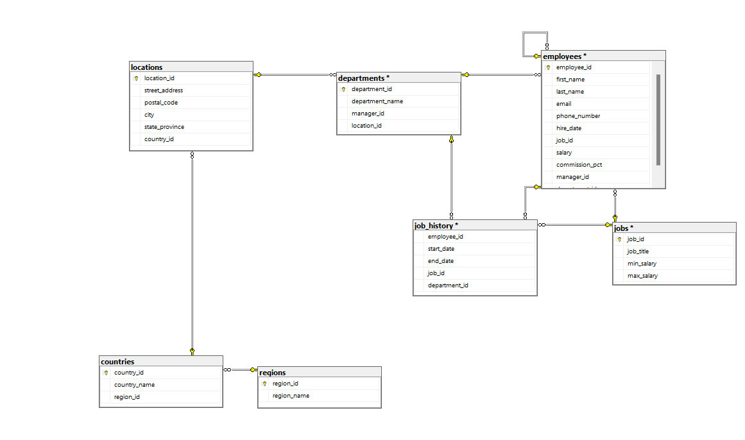
SCHEMA

Slide 5
BUSINESS QUESTIONS
What is each employee's department?
Get all the managers and employees who manage it.
How many employees does each manager manage?
How many employees are there in each job title?
Compare employee salaries with the salaries set by the company.
Who are the employees who were promoted?
Get information about the number of employees and salary in each department.
How many employees are there in each city and what is their average salary?
What is the turnover rate per manager?

Slide 6
DATA CLEANING

Slide 7
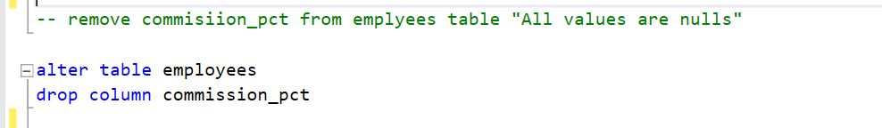
DATA CLEANING PHASE
remove the commission_pct column from the employees table because all the values ​​are NULL.

Slide 8
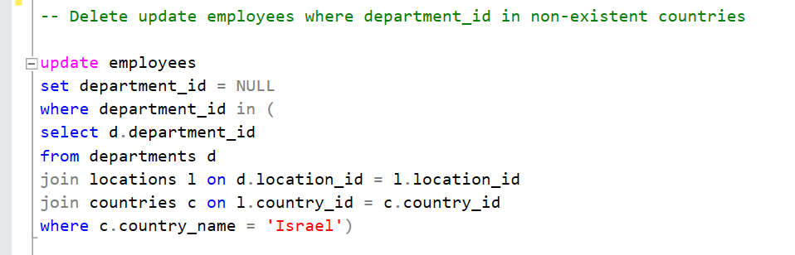
DATA CLEANING PHASE
2. Update employees where the department is in non-existent countries.

Slide 9
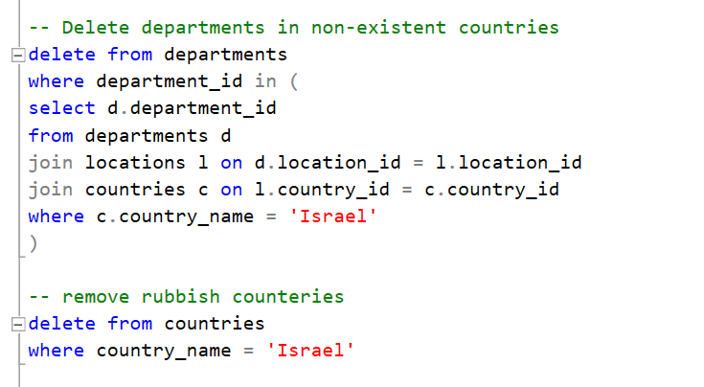
DATA CLEANING PHASE
3. Delete the Departments in the non-existent countries and delete these countries

Slide 10
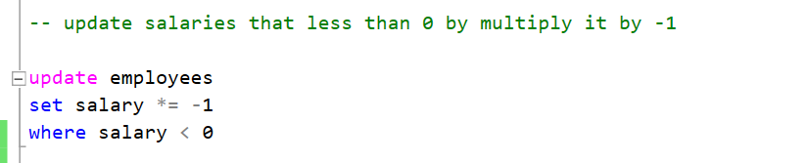
DATA CLEANING PHASE
4. Clean salary column that contains values ​​less than 0

Slide 11
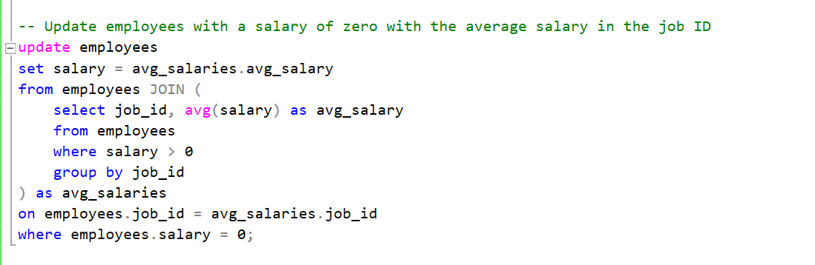
DATA CLEANING PHASE
5. Update employees with a salary of zero with the average salary in the job ID

Slide 12
EXPLORATORY DATA ANALYSIS

Slide 13
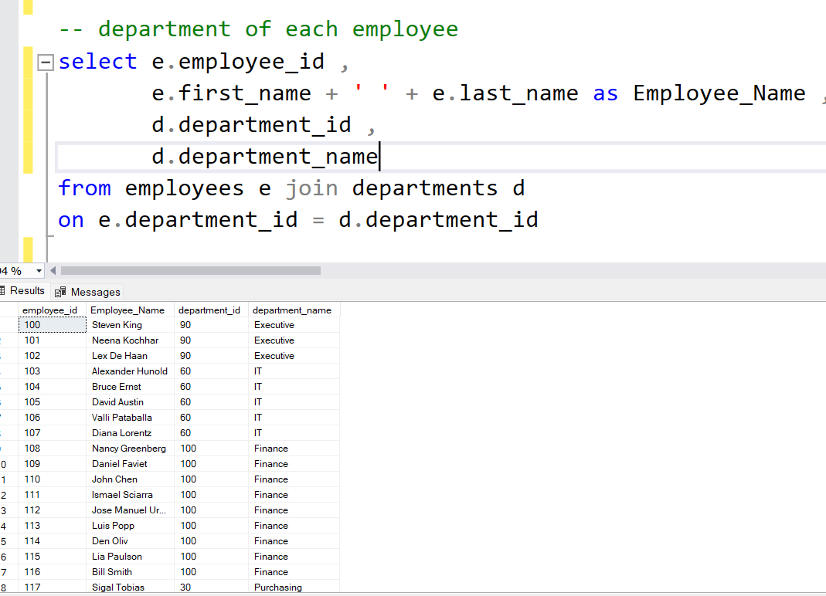
EXPLORATORY DATA ANALYSIS
each employee's department

Slide 14
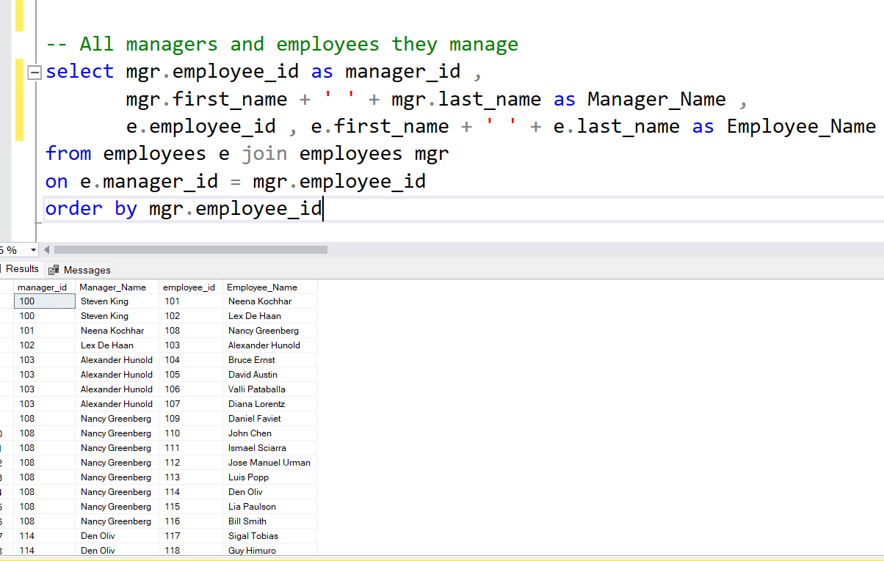
EXPLORATORY DATA ANALYSIS
All managers and employees they manage

Slide 15
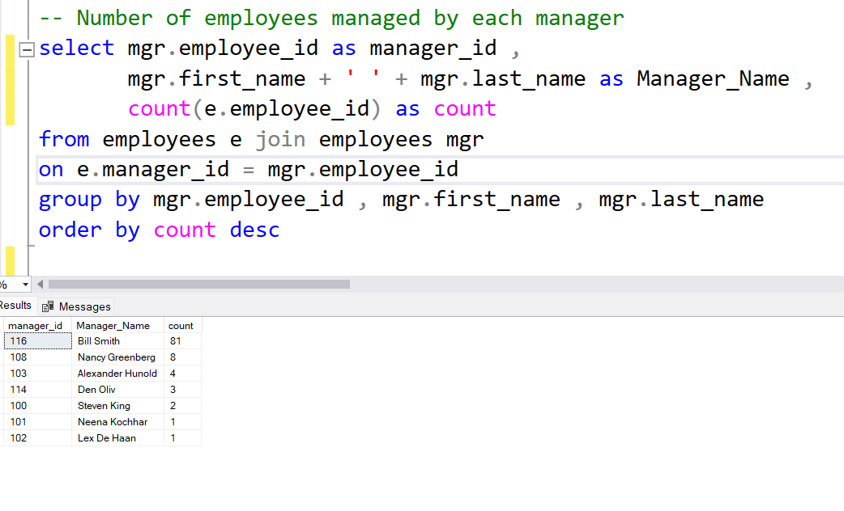
EXPLORATORY DATA ANALYSIS
Number of employees managed by each manager

Slide 16
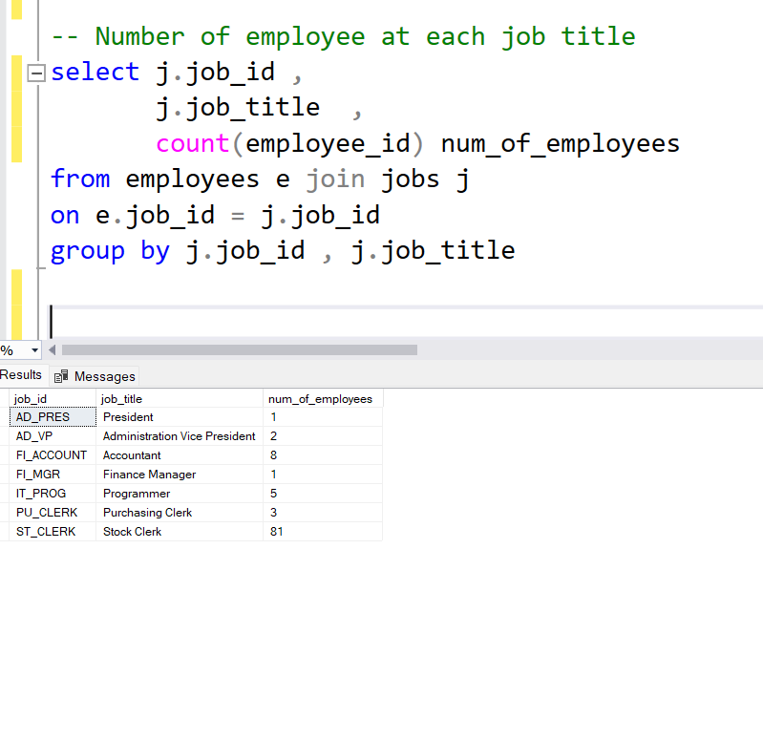
EXPLORATORY DATA ANALYSIS
Number of employee at each job title

Slide 17
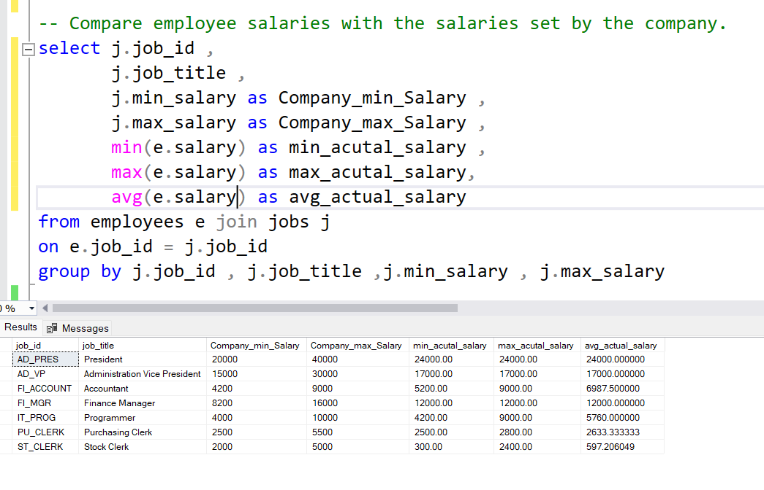
EXPLORATORY DATA ANALYSIS
Comparison between employee salaries with the salaries set by the company.

Slide 18
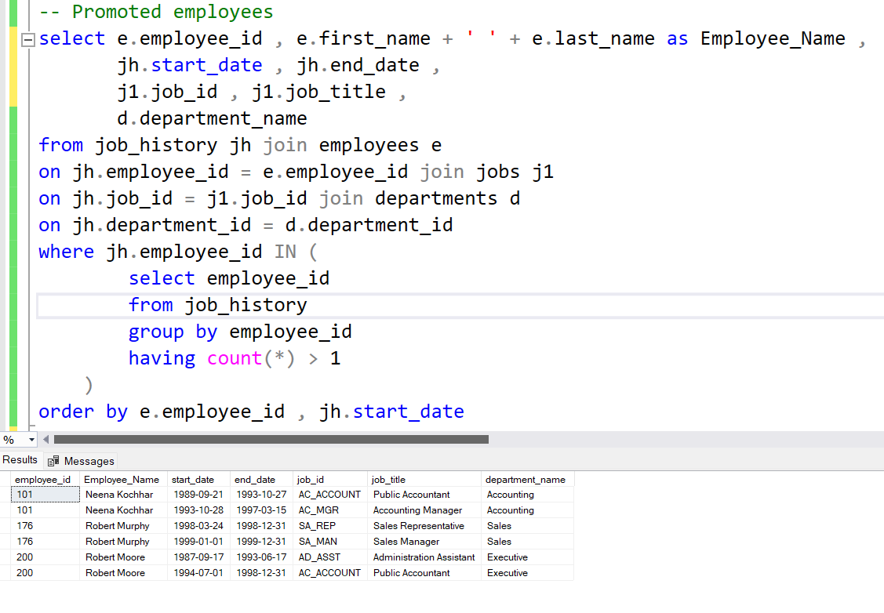
EXPLORATORY DATA ANALYSIS
Promoted employees

Slide 19
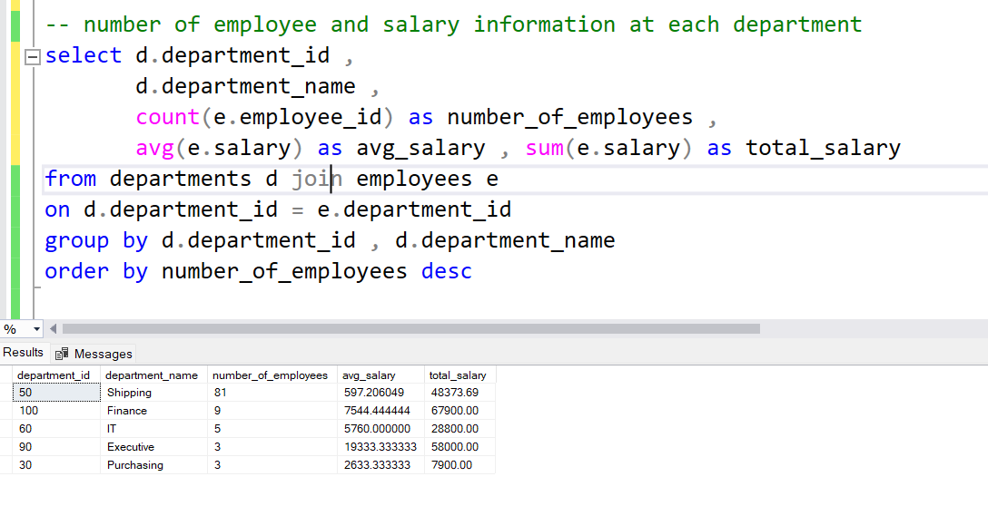
EXPLORATORY DATA ANALYSIS
number of employee and salary information at each department

Slide 20
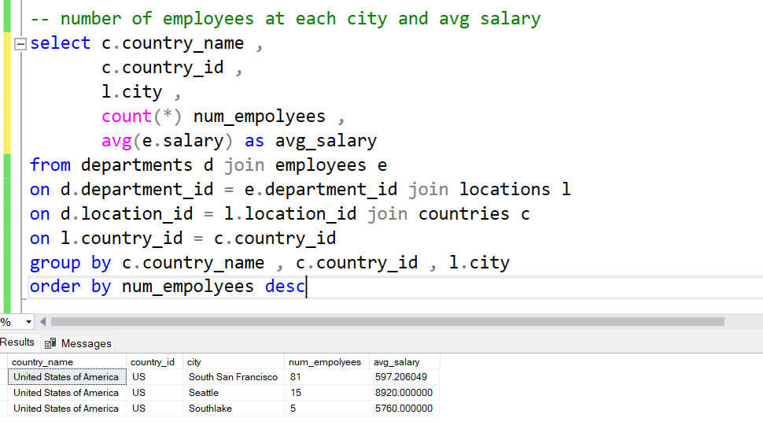
EXPLORATORY DATA ANALYSIS
number of employees at each city and avg salary

Slide 21
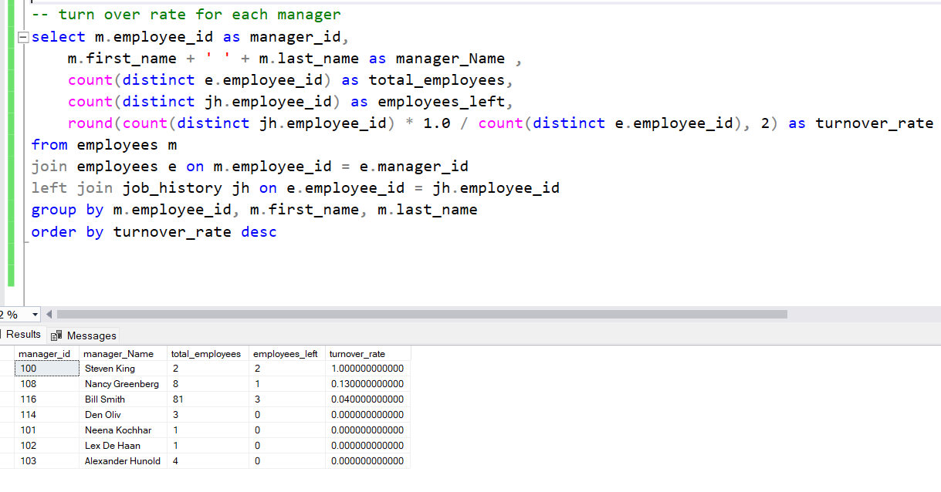
EXPLORATORY DATA ANALYSIS
Turnover rate for each manager

Slide 22

SUMMARY OF FINDINGS
MAX AVERAGE SALARY DEPARTMENT
The Executive department stands out with the highest average salary, reflecting the seniority and critical roles within this department.
SALARY ADJUSTMENTS
During the analysis, it was discovered that some employees had a salary recorded as 0. These discrepancies were addressed by updating their salaries to match the average salary for their respective job titles. This adjustment ensures a more accurate representation of the company’s salary distribution.
SALARY RANGE COMPLIANCE
It was also identified that some employees were earning below the established salary range for their job titles as set by the company. This finding suggests a need for further review and potential adjustments to ensure equitable compensation across all job roles.

Slide 23


FUTURE WORK
Investigate the reasons behind salaries falling below the designated ranges.
Analyze the impact of these salary discrepancies on employee turnover and job satisfaction.
Expand the analysis to include additional factors such as benefits, performance, and employee feedback.

Slide 24



Ahmed Ali Ali Mahmoud
THANK YOU
Cairo,Egypt
+201142092491
We look forward to working with you

